Slide 1

Customer Churn Prediction
Presented By:
Shazni Ahamed

Slide 2
Agenda
Introduction
Data Exploration and Preprocessing
Feature Engineering Techniques and Their Justification
Model Description
Evaluation Results and Interpretations
Conclusions and Possible Extensions and Improvements

Slide 3
Introduction
Problem statement and the approach:
Telecom customer churn is a significant issue impacting the industry, leading to revenue loss and customer dissatisfaction.
Approach involves developing a machine learning model using the Random Forest Classifier to predict customer churn, enabling proactive retention strategies.

Slide 4



Overview of the dataset:
The dataset (telecom_churn_data.csv) contains information about telecom customers, including various features and the target variable (churn).
Data Exploration and Preprocessing
Data exploration insights:
From EDA the patterns were identified, indicating potential factors contributing to customer churn. Correlations were observed between specific features and churn, providing valuable insights for model development.
Preprocessing steps taken: Missing values were handled, categorical variables were converted to numerical form, and the dataset was split into training and testing sets.

Slide 5

Feature Engineering Techniques and Their Justification
Feature engineering techniques used:
Here I applied several feature engineering techniques(Binning, Scaling, etc.) to enhance the predictive capabilities of my ML model.
These techniques included converting categorical variables into numerical variables, resampling numerical data, and grouping numerical data.

Slide 6
Justification for Feature Engineering
Converting Categorical Variables into Numerical Enhances model compatibility, captures ordinal relationships, facilitates mathematical operations.
Resampling Numerical Data Balances class distribution, improves model robustness, enhances sensitivity to minority classes.
Grouping Numerical Data Simplifies analysis, handles non-linearity, facilitates feature engineering.

Slide 7
1. Describe the Random Forest Classifier:
The Random Forest Classifier is an ensemble model that combines multiple decision trees to make predictions.
It is a powerful and versatile algorithm that can handle both numerical and categorical data.
2. Technical details of the model:
Used Random Forest Classifier with 100 estimators (decision trees), a Gini impurity criterion, a random state of 100 for reproducibility, a maximum depth of 6, and a minimum of 8 samples leaf.
3. Training the model:
The model was trained using the training data, where it learned patterns and relationships between features and the target variable (churn).
Model Description

Slide 8
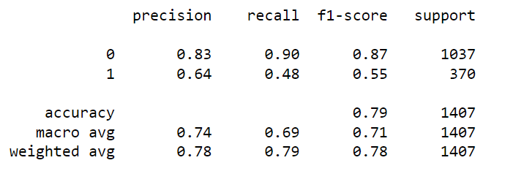
Evaluation Results and Interpretations
Evaluation metrics:
The accuracy score of the Random Forest Classifier model on the test data was calculated, showing the overall predictive performance.
Interpretation of the classification report:
The classification report provides insights into the model's performance for both the non-churned (0) and churned (1) classes.
Precision, recall, F1-score, and support for each class are presented, allowing us to assess the model's effectiveness in identifying churned customers.

Slide 9
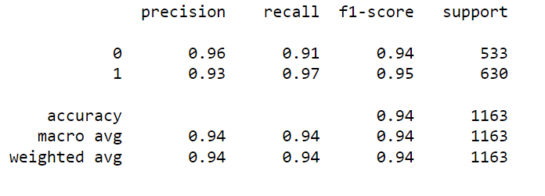
Strengths and weaknesses of the model:
The model effectively handles numerical and categorical data, leveraging feature engineering techniques. However, class imbalance may impact predictions. To address this, the SMOTEENN algorithm is employed. Further improvements can be made by exploring alternative algorithms and additional features.

Slide 10
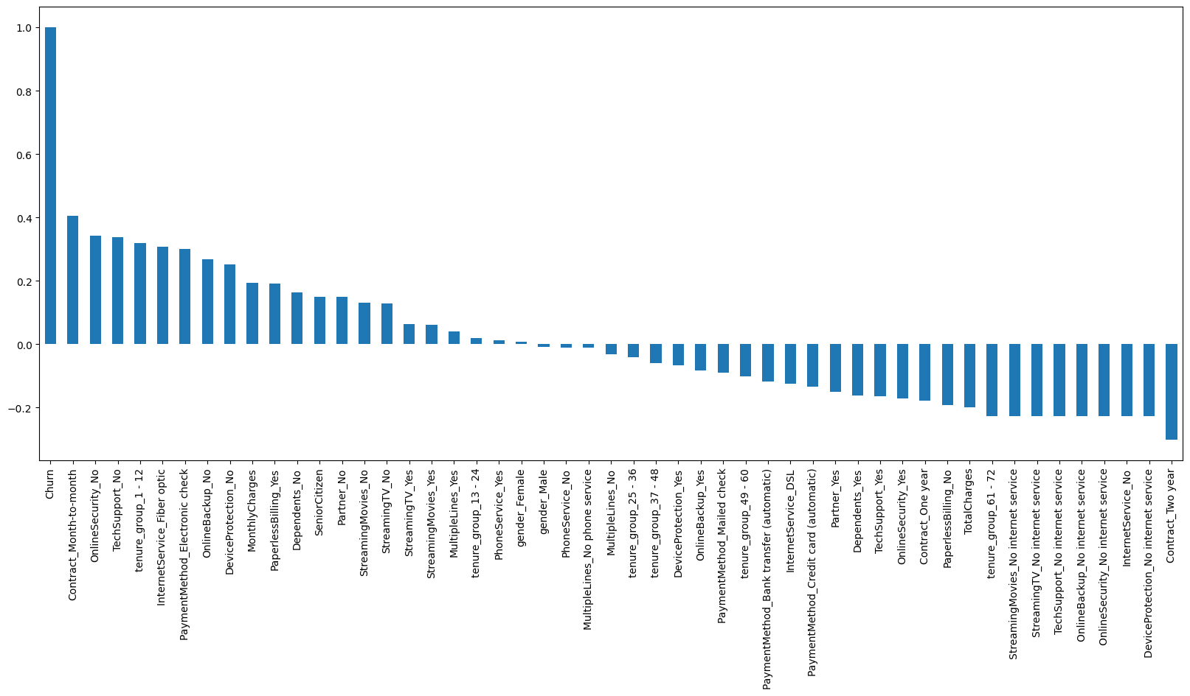
Conclusions and Possible Extensions:

Slide 11
Main findings:
The analysis reveals important predictors of customer churn, such as customers without a partner, using electronic check payment method, and having monthly contracts. Lack of online security and tech support also contribute to higher churn rates. The Random Forest Classifier demonstrates accurate churn predictions.
Model effectiveness:
The model performs well, with a high accuracy score, enabling businesses to proactively retain customers by identifying potential churners effectively.
Possible extensions or improvements:
Future improvements could involve incorporating additional data sources, exploring different machine learning algorithms, and implementing advanced techniques for handling class imbalance beyond SMOTEENN. These steps would further enhance the model's predictive capabilities.

Slide 12
Thankyou
Questions?

